Slide 1


LIWA — ሊዋ
Unlocking Billions in Latent Asset Value Through Secure Peer-to-Peer Barter.
Bridging traditional offline trading memory with modern scale-ready platform security.
EXECUTIVE PITCH DECK
LIWA.COM | 2026
01

Slide 2

The Perfect Digital Storm
139.5M Mobile Wallets
Regulatory Safety Nets
Driven by the National Bank of Ethiopia’s National Digital Payments Strategy (2026–2030), digital wallets and transaction frameworks have saturated consumer behaviors nationwide.
The landmark Startup Proclamation implementation, backed by a sovereign Fund of Funds, creates an unprecedented structural platform and asset safety mechanism.
MACRO CONTEXT
REF: LIWA FINTECH PRESENTATION.PPTX
02

Slide 3






The Friction of Offline & Idle Assets
Locked Capital
Drawer Waste
Paradox of Trust
High inflation and currency depreciation restrict immediate fiat purchasing power, preventing consumer tech upgrades.
Millions of Birr of functioning gadgets sit completely idle in closets because cash liquidation incurs massive merchant losses.
Consumers hold valuable assets they desire to exchange, but lack a transaction engine that handles secure value negotiation.
PROBLEM DEFINITION
REF: LIWACH APP REVERW.DOCX
03

Slide 4
Critical Gaps in Existing Platforms
Structural Point | What Competing Apps Lack (Weaknesses) | Liwa Platform Resolution
Listing Clogging | Forgotten stale items remain in database forever. | 14-Day Auto-Stale Delete & Archive
Negotiation Security | Price/item details can be edited mid-chat, causing theft. | Bilateral Lock-In locks terms inside chat
Communication Rules | Direct voice calls leak users off-app; leads to scam. | Secure Chat-Only Mandate & Metadata analysis
Posting Safeguards | No vetting of listings; flooded with retail spam. | 250 ETB Premium Limit for consecutive active ads
MARKET ANALYSIS
REF: LIWACH APP REVERW.DOCX
04

Slide 5
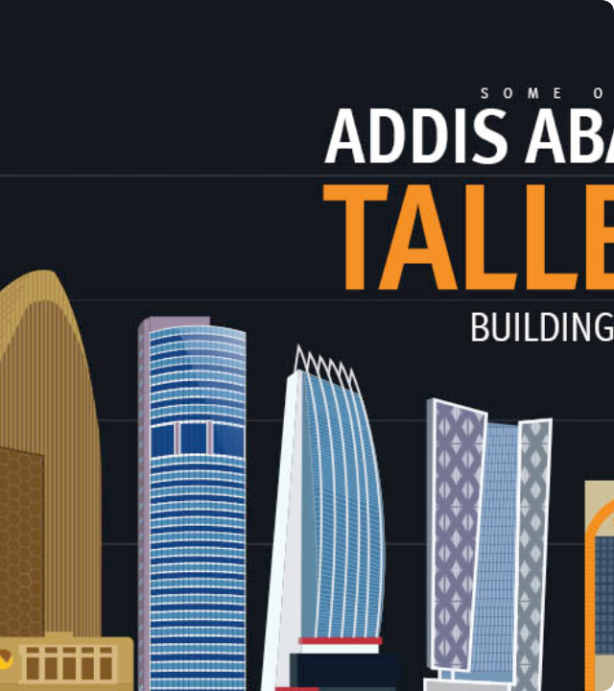
A New Engine for Barter
Liquifying Physical Capital
Liwa shifts unstructured classified listing into verified transaction-driven swap networks, optimizing how peer assets are valued.
By embedding value comparisons directly into user feeds, Liwa bridges Ethiopia's centuries-old "Liwach" trading culture with automated, secure verification.
SOLUTION STATEMENT
LIWA P2P PLATFORM
05

Slide 6

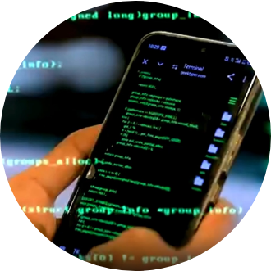
Demographic Wedge & Asset Classes
2.8M Tech-Savvy Digital Natives
Liwa's initial beachhead targets young urban tech-savvies cycling through phones, gaming gear, and premium clothing accessories inside Addis Ababa.
Highly active across social media and digital mobile money networks, this cohort acts as the high-velocity engine that launches the platform's liquidity loops.
TARGET MARKET
DEMOGRAPHIC STRATEGY
06

Slide 7
Gamified Feed Discovery
Swipe Engine
Value Auction
Guest Browsing
Moving past static vertical listings to dynamic swipe-to-match exploration that simulates native mobile behaviors.
Sellers compare multiple active buyer bids at once, allowing them to optimize for the highest-value combination.
Enables free browsing and exploration; profile registration is deferred until a transaction commences.
PRODUCT MECHANICS
THE SWAP FEED
07

Slide 8
Eradicating Meetup Low-Balling
Cryptographic Agreement
Value Overlay Guarantees
Once swap parameters (e.g. Asset A + 1,500 ETB for Asset B) are negotiated within the chat, the platform freezes listing variables permanently to suppress mid-way modification attempts.
Liwa overlays real-time item value comparisons on chat screens, warning users algorithmic markers if proposal values fall beneath 60% of benchmark guidelines.
CORE PRODUCT
BILATERAL LOCK-IN
08

Slide 9

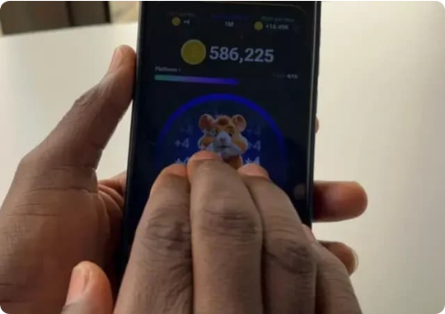
Closing the Handover Fraud Loop
QR Verification Handover
Most marketplace fraud happens at physical meetups. Liwa implements strict transaction finality: once goods are inspected, both parties must scan complementary QR codes.
Scanning instantly updates the ledger, locks transaction ratings, and releases held wallet balances via integrated gateway APIs safely.
PRODUCT SECURITY
QR HANDOVER
09

Slide 10
Competitive Landscape Strategy
Capability Segment | Generic Classifieds | Unregulated Telegram Channels | LIWA P2P Platform
Trust Verification | None (Anonymous profiles) | None (Anarchy) | 250 ETB Partner Assessment
Negotiation System | Unstructured direct calling | Chaos messaging | Bilateral Lock-In state machine
Low-ball Safeguards | Absent (Aggressive spam) | Absent | Algorithmic warnings (< 60% value)
Reputation Mechanics | None | None | Integrated community verified score
MARKET POSITIONING
COMPETITIVE MATRIX
10

Slide 11
The Business Model
Low Friction Entry, High-Value Capture
55%
First Swap Free: 100% free account operations for the initial 30 days or until the first transaction closes, driving unmatched early user acquisition.
Spam Suppression Filters: The first active listing is free. Successive concurrent listings carry a 250 ETB assessment fee, purging mercantile clutter and keeping user trust exceptionally high.
ORGANIC TRIAL CONVERSION
BUSINESS MODEL
MONETIZATION FLOWS
11

Slide 12
Trust Engineering & Chat Rules
Chat-Only Mandate
Economic Sanctions
Low Headcount
Voice calls are completely blocked in-app. Retaining 100% of negotiation metadata enables systemic fraud prevention.
Reported bad behaviors trigger profile status drops. Restoring verification requires a strict 250 ETB re-vetting fee.
Self-policing community feedback and reputation metrics reduce operational overhead and support staff scaling requirements.
ECOSYSTEM TRUST
REF: LIWACH APP REVERW.DOCX
12

Slide 13
Infrastructure Storage Hygiene
14-Day Auto-Archive Rule
Optimized Firestore Queries
Inactive classified listings pollute search queries and multiply cloud server expenditures. Liwa automatically archives any asset with zero buyer interactions for 14 straight days.
Push notifications request users to reactivate or confirm sale. This simple database garbage cleaning rule keeps indexing queries lean, preserving high margin operations on AWS/Firebase.
PLATFORM SCALING
CLOUD OPTIMIZATION
13

Slide 14
Go-To-Market Strategy: Phase 1
AAU Campus Hubs
Viral TikTok Content
Swap Meets
Direct activations on Addis Ababa University campuses targeting students swapping gadget accessories and apparel.
Partnering with microtech creators showcasing actual, high-value trades (e.g. trading three dormant gadgets for a phone).
Sponsoring physical swap meet events across Bole tech cafes to assist users log their first dormant closet asset.
GTM STRATEGY
PHASE 1 LAUNCH
14

Slide 15

GTM Expansion Strategy: Phase 2
Verified Liquidators
Substantial Asset Categories
Onboarding electronics repair boutique shops and secondhand brokers as certified liquidity points to buy up uneven asset-and-cash configurations safely.
Rolling out subsequent modules for high-net-worth demographic cohorts trading vintage collectibles, vehicles, and real estate configurations inside Addis Ababa.
GTM STRATEGY
PHASE 2 EXPANSION
15

Slide 16



Financial Modeling & Scalability
Scale Metrics
Revenue Equations
Targeting 50,000 active urban traders inside Addis Ababa in Year 1, converting 55% of the organic funnel into long-term users paying the 5 ETB active baseline fee.
Baseline calculations scale proportionally with the optimization of database queries, offsetting operational costs easily.
MONTHLY PLATFORM NET REVENUE
FINANCE MODELING
MATHEMATICAL FOUNDATIONS
16

Slide 17
Ecosystem Defensibility Risk Grid
Identified System Risk | Potential Strategic Impact | Liwa Core Mitigating Shield
Platform Cash Leakage | Users closing financial margins off-platform. | Link escrow/satisfaction parameters strictly to API balances
Digital Literacy Gaps | Users finding complex state machines confusing. | Amharic/Oromiffa UI designs with highly visual layout vectors
Spotty Edge Connectivity | Network timeout disruptions during meetup finalization. | Device local caching matching Ethio Telecom edge configurations
ECOSYSTEM CONTROLS
RISK STRATEGY
17

Slide 18
Product & Expansion Roadmap
Phase 2: Wallet
Phase 4: Logistics
Launch built-in integrated escrow wallet and automated item depreciation pricing tools.
Integrate specialized urban micro-logistics and delivery loops across Adama & Hawassa.
Phase 1: Core
Phase 3: AI
Launch Chat-Only core P2P barter transaction engine & QR Code finality in Addis Ababa.
Deploy camera-driven AI product recognition system for listing creation; scale regional hubs.
STRATEGIC PLANNING
PRODUCT TIMELINE
18

Slide 19
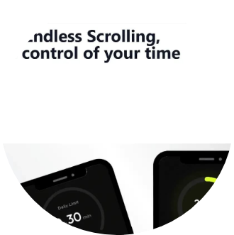
Execution Capabilities
Founders & Advisors
CEO & Product Strategist: Deep startup domain knowledge in the Addis tech network with extensive design history.
CTO & Architect: Expert in Firebase serverless environments and cross-platform native SDK wrappers.
Advisory Board: Strategic operations managers from Ethiopia's top payment gateway networks.
EXECUTION POWER
THE TEAM
19

Slide 20

Let's Talk.
Liwa is currently seeking Seed Capital to complete engineering locks, scale viral TikTok-led consumer acquisition channels, and solidify regulatory gateway integrations.
Michaele Ermias Baye | send2michaele@gmail.com
Platform Blueprint Reference: Liwa Fintech Presentation.pptx & Liwach app Reverw.docx
STRATEGIC PARTNER ASK
PLATFORM LAUNCH 2026
20

Slide 21




Image Sources
https://reqiq.co/wp-content/uploads/2023/03/Reqiq.co-%E2%80%94-Tallest-Buildings-of-Addis-Ababa-%E2%80%94-Meta.jpg
Source: reqiq.co
https://www.ena.et/documents/42142/0/coders+2+%281%29.jpg/a43f22f4-3fff-5ae1-390f-148c55dbb2a0?version=1.0&t=1767113598619&download=true
Source: www.ena.et
https://shega.co/_next/image?url=https%3A%2F%2Fshegastrpool.blob.core.windows.net%2Fmedia-prod%2Fmedia-prod%2F132ce560_7cbc_11ef_bf4b_ef19cfbf3842_png_2a700e83ab.webp&w=1920&q=75
Source: shega.co
https://shega.co/_next/image?url=https%3A%2F%2Fshegastrpool.blob.core.windows.net%2Fmedia-prod%2Fmedia-prod%2FScreenshot_2026_03_09_110227_4df9b79521_8c62219fcd.webp&w=1920&q=75
Source: shega.co

